Slide 1
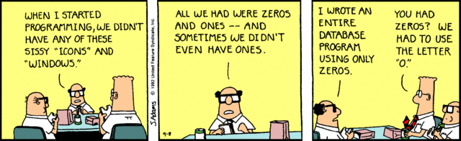
Welcome SYST 10049
Web Design with HTML 5

Slide 2


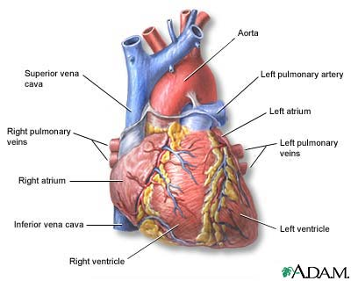

Introductions
Rich Smith:

Slide 3
What I Expect From You
How do you think you can excel at this course?
How do you think you can fail this course?

Slide 4
What I Expect From You
How to excel!
  Attend the classes and pay attention.
  Keep good notes and organize your programs, notes and slides well.
  Do the assigned exercises and assignments.
  Contact me if you are having problems

Slide 5
Speaking of which…
Let’s go to housekeeping….

Slide 6
Please don’t do this to me!!!
Every year, there are a few students who:
  rarely show up to class or alway shows up late
  don’t do the assignments or copy the assignments from other students
  skip the quizzes or don’t study
  don’t keep up with the exercises and reading...
And then...

Slide 7
And then...
Show up 3 days before the exam wanting extra help to try to squeeze an entire term into a few hours...
Start sending me emails after the final exam, begging me to pass them because:
  Their parents will be furious
  They will be kicked out of school
  They will lose all that money
  They don’t have enough money to take the course over again...

Slide 8
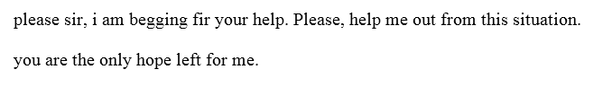
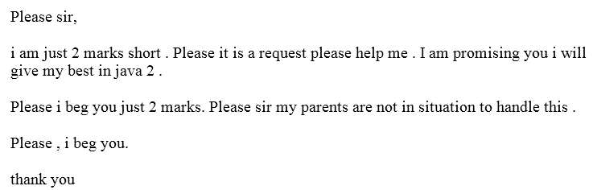

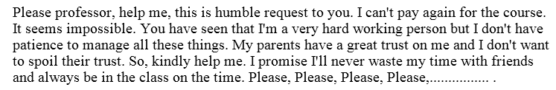
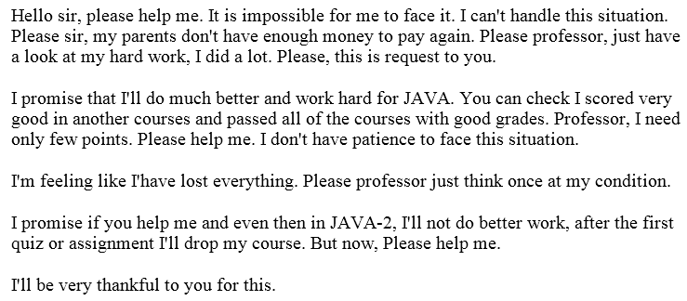
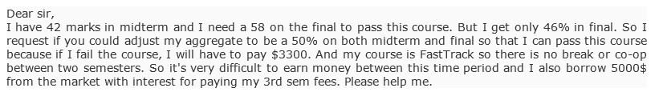
My job is to mark what you give me…not to give you marks…which I won’t do
Don’t even ask…
It will just make us both feel bad.
If you fail the final exam, and need .5% to pass the course,
I will not give it to you…

Slide 9
Don’t do this to me!!!
I must mark the work that you give me.
I can only pass you if you prove that you understand the material and are ready for your next courses!
I can not and WILL NOT pass you due to hardships, parents, money, begging, because you are nice, because you will do better next time...
Please don’t put me in that situation!!!

Slide 10
What You Can Expect From Me
I will teach you the technology
I will teach you how to thrive in the workforce
I will treat you more like an employee than a student
If you ask me for help, I will help you!
If you are having problems, come see me!
I will try to make it fun!

Slide 11
Course Evaluation
Rich Factor
In Class Assignments 10%
Take Home Assignments 40%
Mid Term Exam 25%
Final Exam 25%
Attitude and Professionalism will play a part as well!
You must have an average of 50% on
all three exams in order to pass this course!

Slide 12
Lots of Resources!
Your Prof!
Learning Assistants!
LinkedIn courses
YouTube.com
W3C
The entire Web!
Github Copilot (Be smart about how you use it!)

Slide 13
Take a piece of paper ...

Slide 14
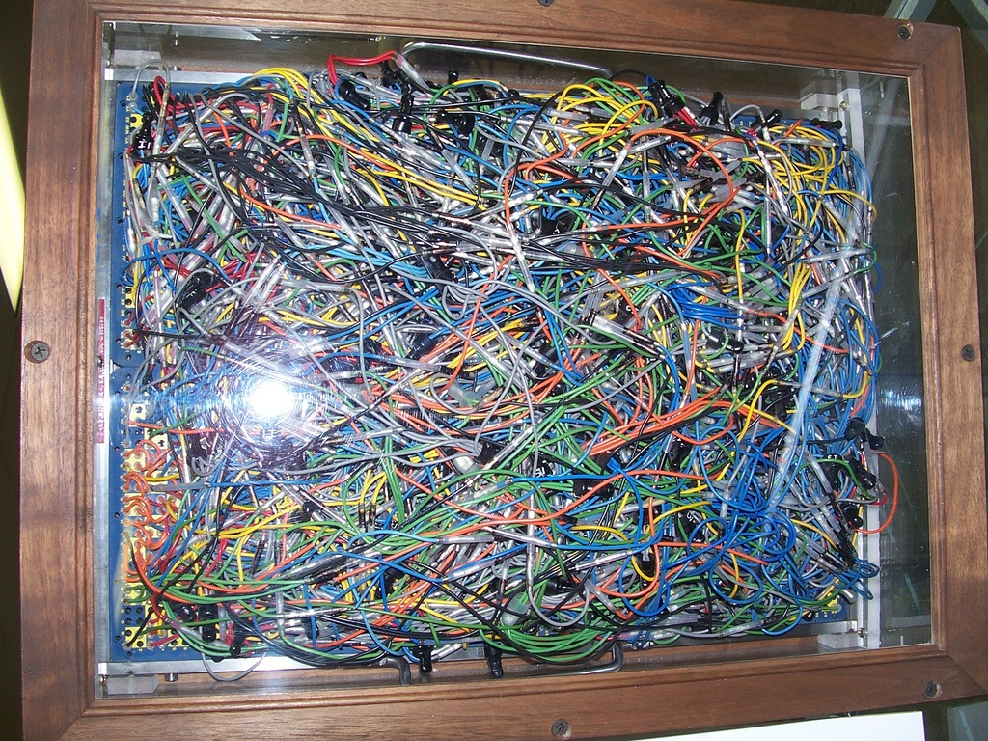
The first missile targeting system
Simple, well organized code is the way to go.

Slide 15
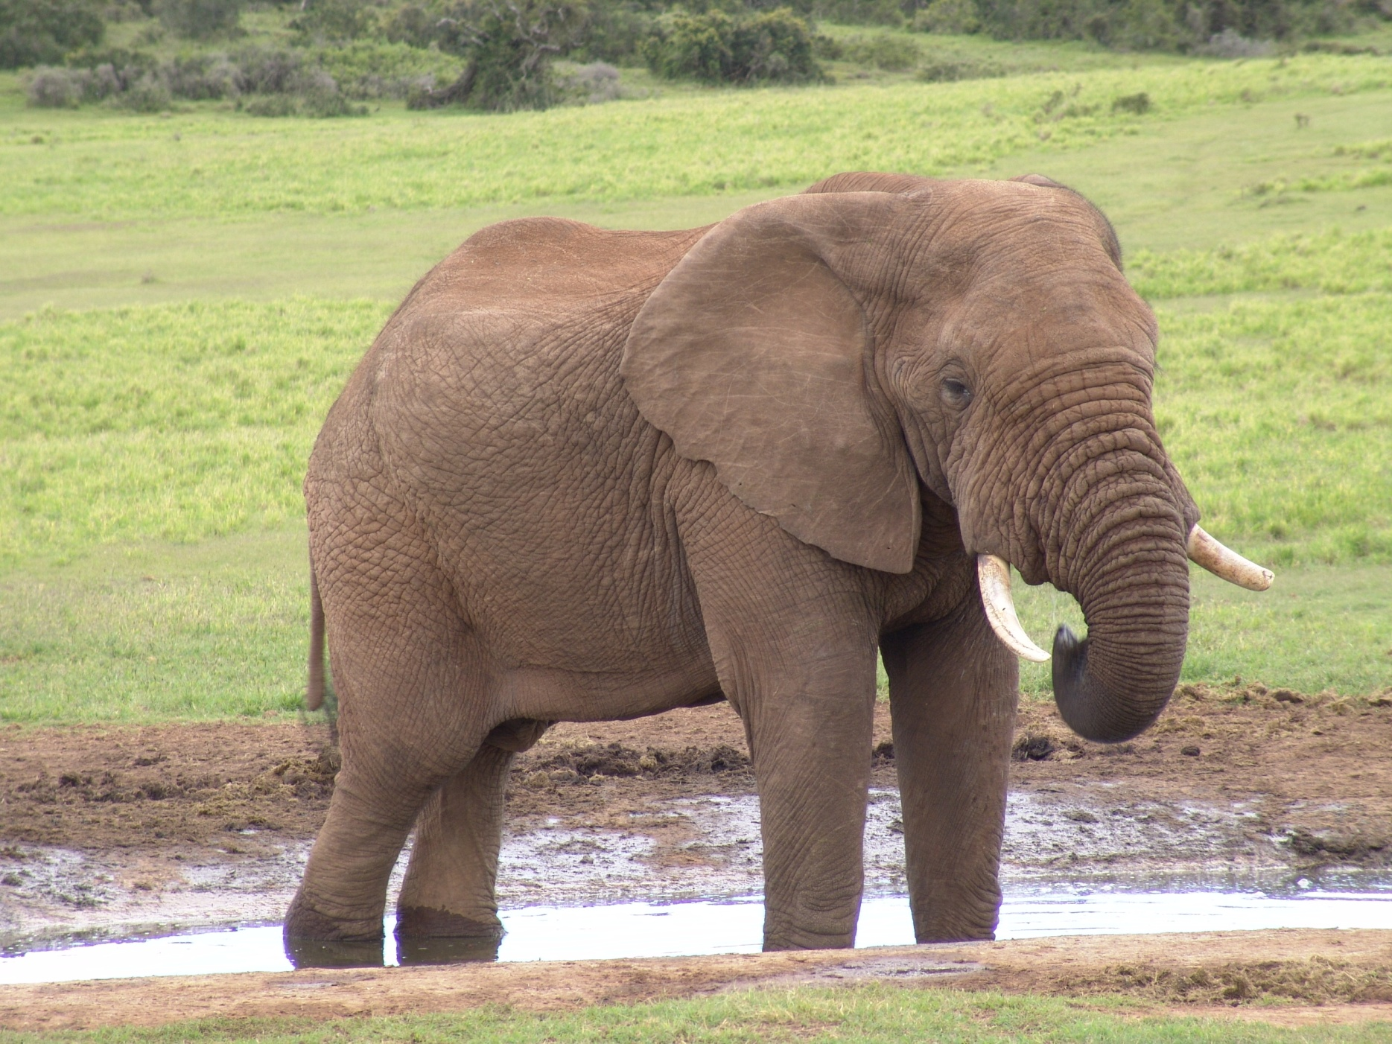
Step back often to consider the entire problem. Don’t jump right into coding.

Slide 16
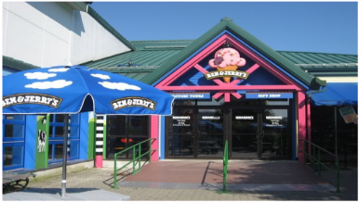
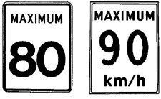
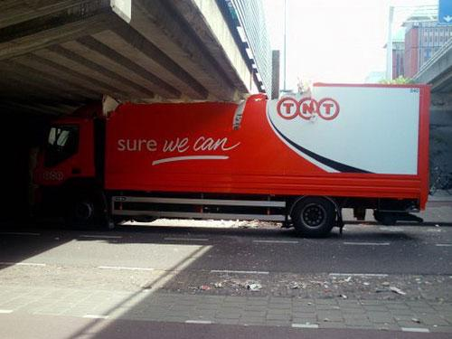
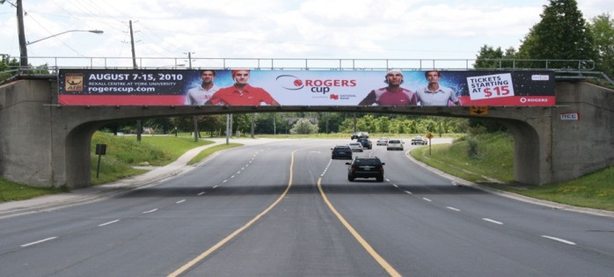
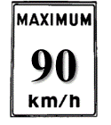
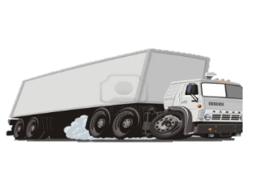
80
5 km
10 km
10 km
20 km
30 km
90
15 km
10 km
Notes:
Feel free to skip this slide.
I like to show it before the next yourturn:
“So, I bought an icecream shop! Now, the trucks that deliver the icecream to me take the route that will cost them the shortest amount of time since they don’t want the icecream to melt. Until recently, they took the middle route as it took the least amount of time. Unfortunately, <click> the city has just built a bridge over the middle route and the bridge is like an <click>inch too low for our trucks to pass under! So which alternate route should the trucks take? Which one is going to be faster? Can you build an algebraic equation to figure it out or can you do some rough calculations to decide which one? Who says the left route? Who says the right route? Left? Right? So, the answer is actually to take the middle route and to lower the air pressure in the truck tires so that it will sit 1 inch lower on the road! There is a lesson here! We don’t want to just jump in and start figuring out the solution. We want to take some time to understand the problem and look at it from different angles! Why am I brining this up? Because there are two ways to solve the next yourturn. Hint, if the problem gets increasingly difficult, you need to look at things from a different angle.

Slide 17
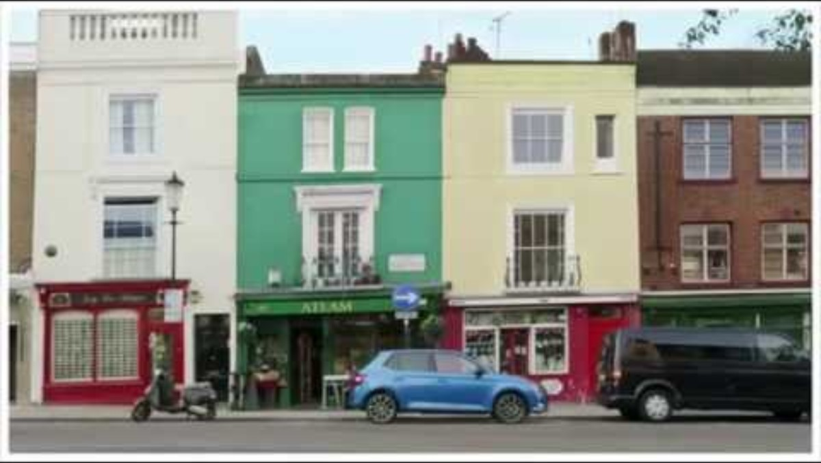
Watch this

Slide 18
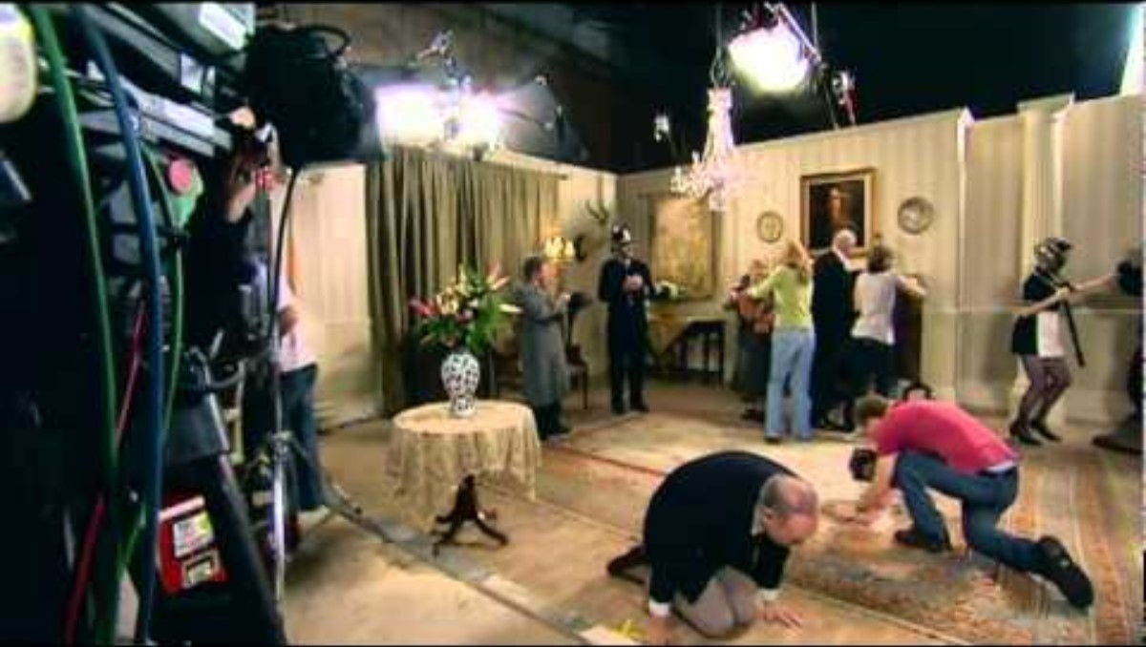
Watch this...

Slide 19
You are given a box containing three light bulbs...
Each light bulb is turned on or off by one of three switches outside the box. Each switch controls one light bulb.
You can only change the switches while the box is closed.
After setting the switches, you may open the box to see the results.
What is the minimum # of times you need to open the box in order to be 100% confident which switch operates which bulb?

Slide 20
Rich’s Laws of Computer Programming
Simple is almost always better.
Organized always is better.
Learn to focus on the problem before you jump in and try to solve it.
Don’t get too absorbed in the code that you are writing. Step back regularly to think about how everything fits together.
Think outside the box
When in doubt, see rules 1-5

Slide 21
The biggest Computer Programming Secret!
Computer Programming concepts are easy!!!
People are not! Technical people often have a predilection towards obfuscating simple concepts through disingenuous circumlocution and the use of superfluous, esoteric, and occasionally archaic acronyms and jargon.
In other words, they use fancy language to describe simple things!
The trick is to see through the jargon and understand the simple concept behind it.

Slide 22
Webdev ClassPlan
What is the internet?!
Lists and Tables
Intro to HTML
A tiny peek into CSS
Accessibility on the web
The DOM
Using the inspect tool in your browser
How a webpage renders
Images
Links
Review
Advanced selections in CSS
Intro to CSS
Styling – colours- gradients, etc
Responsive Web pages
Media Queries
Box, Grid, and Flexbox
Review
Midterm!!!
Final Exam
Week 1
Week 2
Week 3
Week 4
Week 5
Week 6
Week 8
Week 9
Week 10
Week 11
Week 12
Week 13
Week 7
Week 14
Notes:
Check ann week 10

Slide 23
How Big is the internet?
You tell me!
How can you get a good answer?
Notes:
Google, chat gpt etc
Then have them do it and share answers

Slide 24
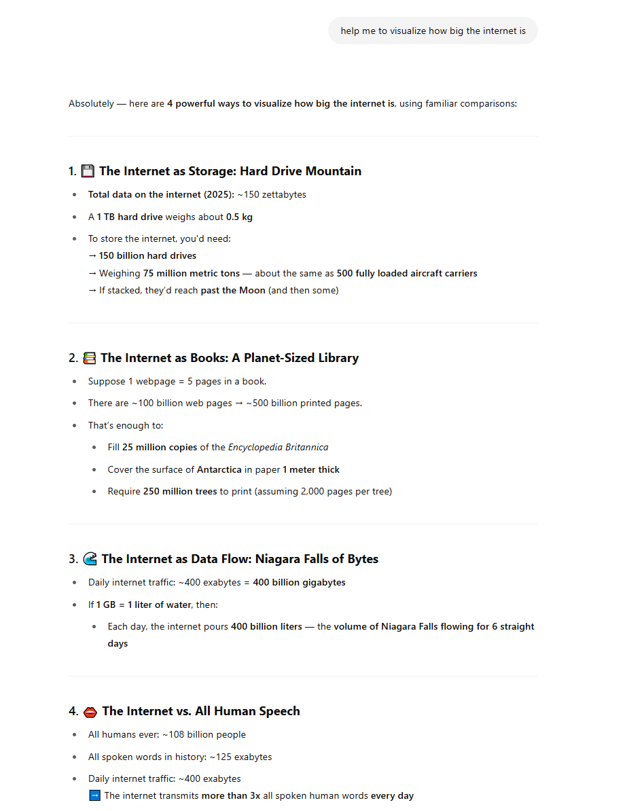
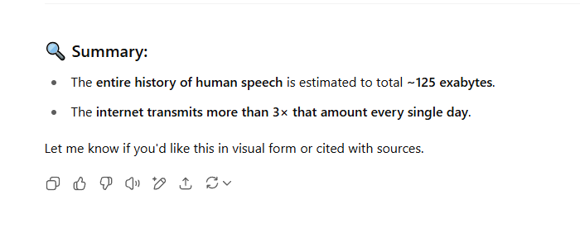
How big is the internet?

Slide 25
Speaking of ChatGPT…
AI is like fire: Use it wisely and it is an excellent tool! Use it foolishly and you’ll burn down your life!

Slide 26
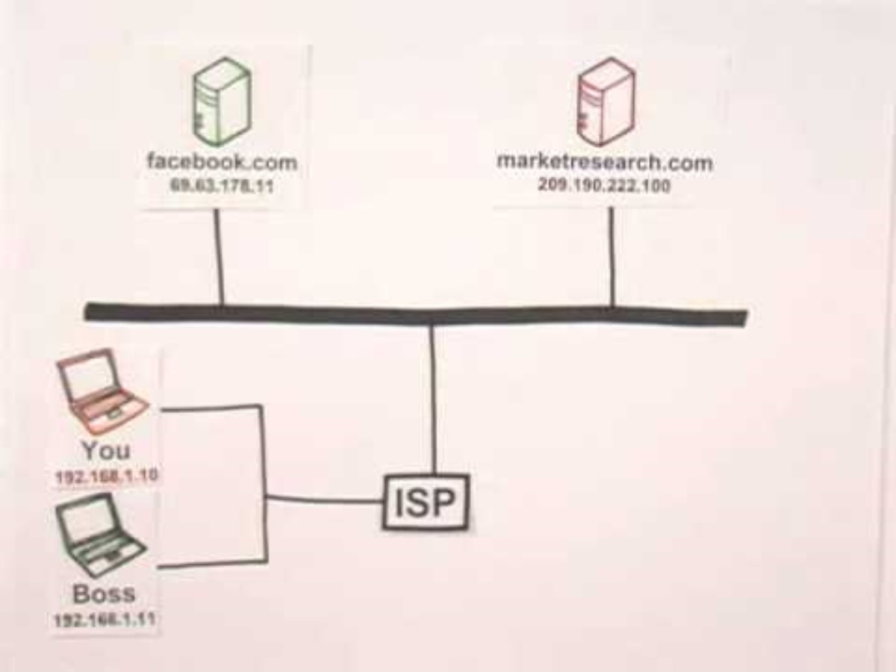
How does the internet work?
How the Internet Works in 5 Minutes

Slide 27
Rich’s History of the Internet!
1974
TCP/IP invented
(50 Nodes on the Arpanet – some overseas)
1983
Arpanet converts 100% to TCP/IP and the internet is born!
1991
Rich Connects to the Internet for the first time!
2015
After years of stagnation, AI begins rapid advances
1969
Arpanet is Invented
2020
Covid drives remote, real time communications
Rich is
Born!
1972
Email was invented
(37 Nodes on the Arpanet)
1990
World Wide Web is born, thanks to Tim Berners-Lee who invented HTML, URLs, and the first web browser
(500+ nodes)
2000’s
Social Media era begins
(millions on the internet)
Streaming video becomes mainstream
2017
CryptoCurrency takes off
1978
Personal Computer era begins
(100 nodes)
Today:
31 billion nodes on the internet!
This is an interesting video: The Web Is Not The Net
Notes:
. 1969 – ARPANET is Born - Origins: ARPANET was funded by the U.S. Department of Defense’s ARPA (Advanced Research Projects Agency). It was designed to facilitate communication between universities, military research centers, and government labs in a more efficient manner.
The first successful message on ARPANET was sent on October 29, 1969 between two computers: one at the University of California, Los Angeles (UCLA) and the other at the Stanford Research Institute (SRI). They were trying to send the word ‘Logon’, but they only got “Lo” before the system crashed! Non the less, ArpaNet worked!!!

Slide 28
What formats of information flow across the internet?
Text, XML, JSON etc
HTML
Images
Video
Audio
VR
???

Slide 29
Where is the internet Headed?
Internet of things (IoT)
  Everything has an IP address!
AI
  Already here but growing so fast!
Web 3.0
  Blockchain
  More decentralized
  Shift away from centralized platforms like Google
Who knows!!!!

Slide 30
So, what is this course all about?
J2EE
ASP
beans
HTML
CSS
.NET
XML
PHP
JSE
Social Media
Rails
Flash
smalltalk
gopher
javascript
Java
C#
opensource
JSON
CGI
AJAX
SprintBoot
Legacy
Where the rubber hits the road!
Plugins
python
Websphere
ColdFusion
C++

Slide 31
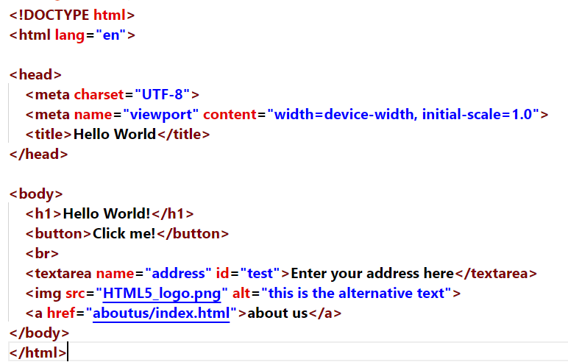

What is this HTML you speak of?
HyperText Markup Language

Slide 32
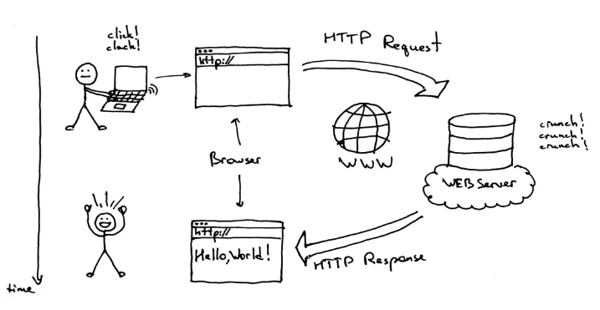
OK, but how does the HTML get to our Computer?

Slide 33
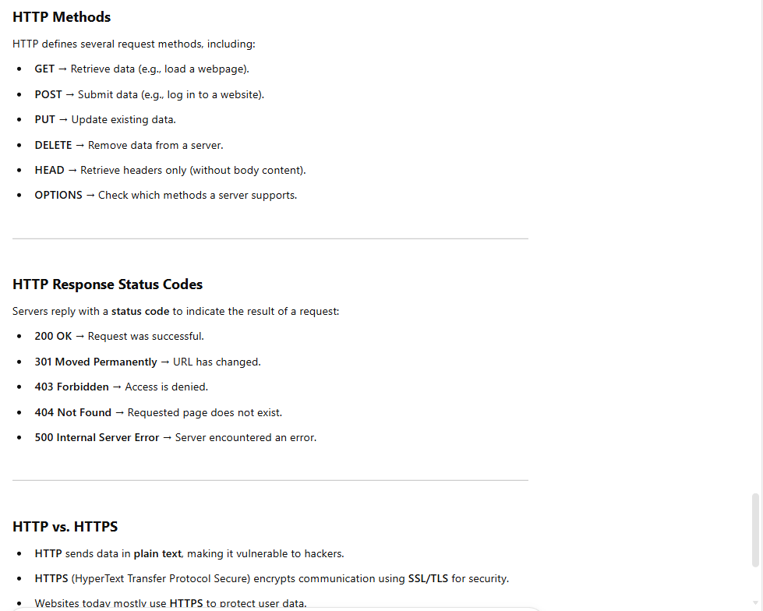
HTTP
HyperText Transfer Protocol:
HTTP is responsible for fetching the HTML from the server to our browser so we can see the webpage

Slide 34
What is the difference between HTTP and HTML?

Slide 35


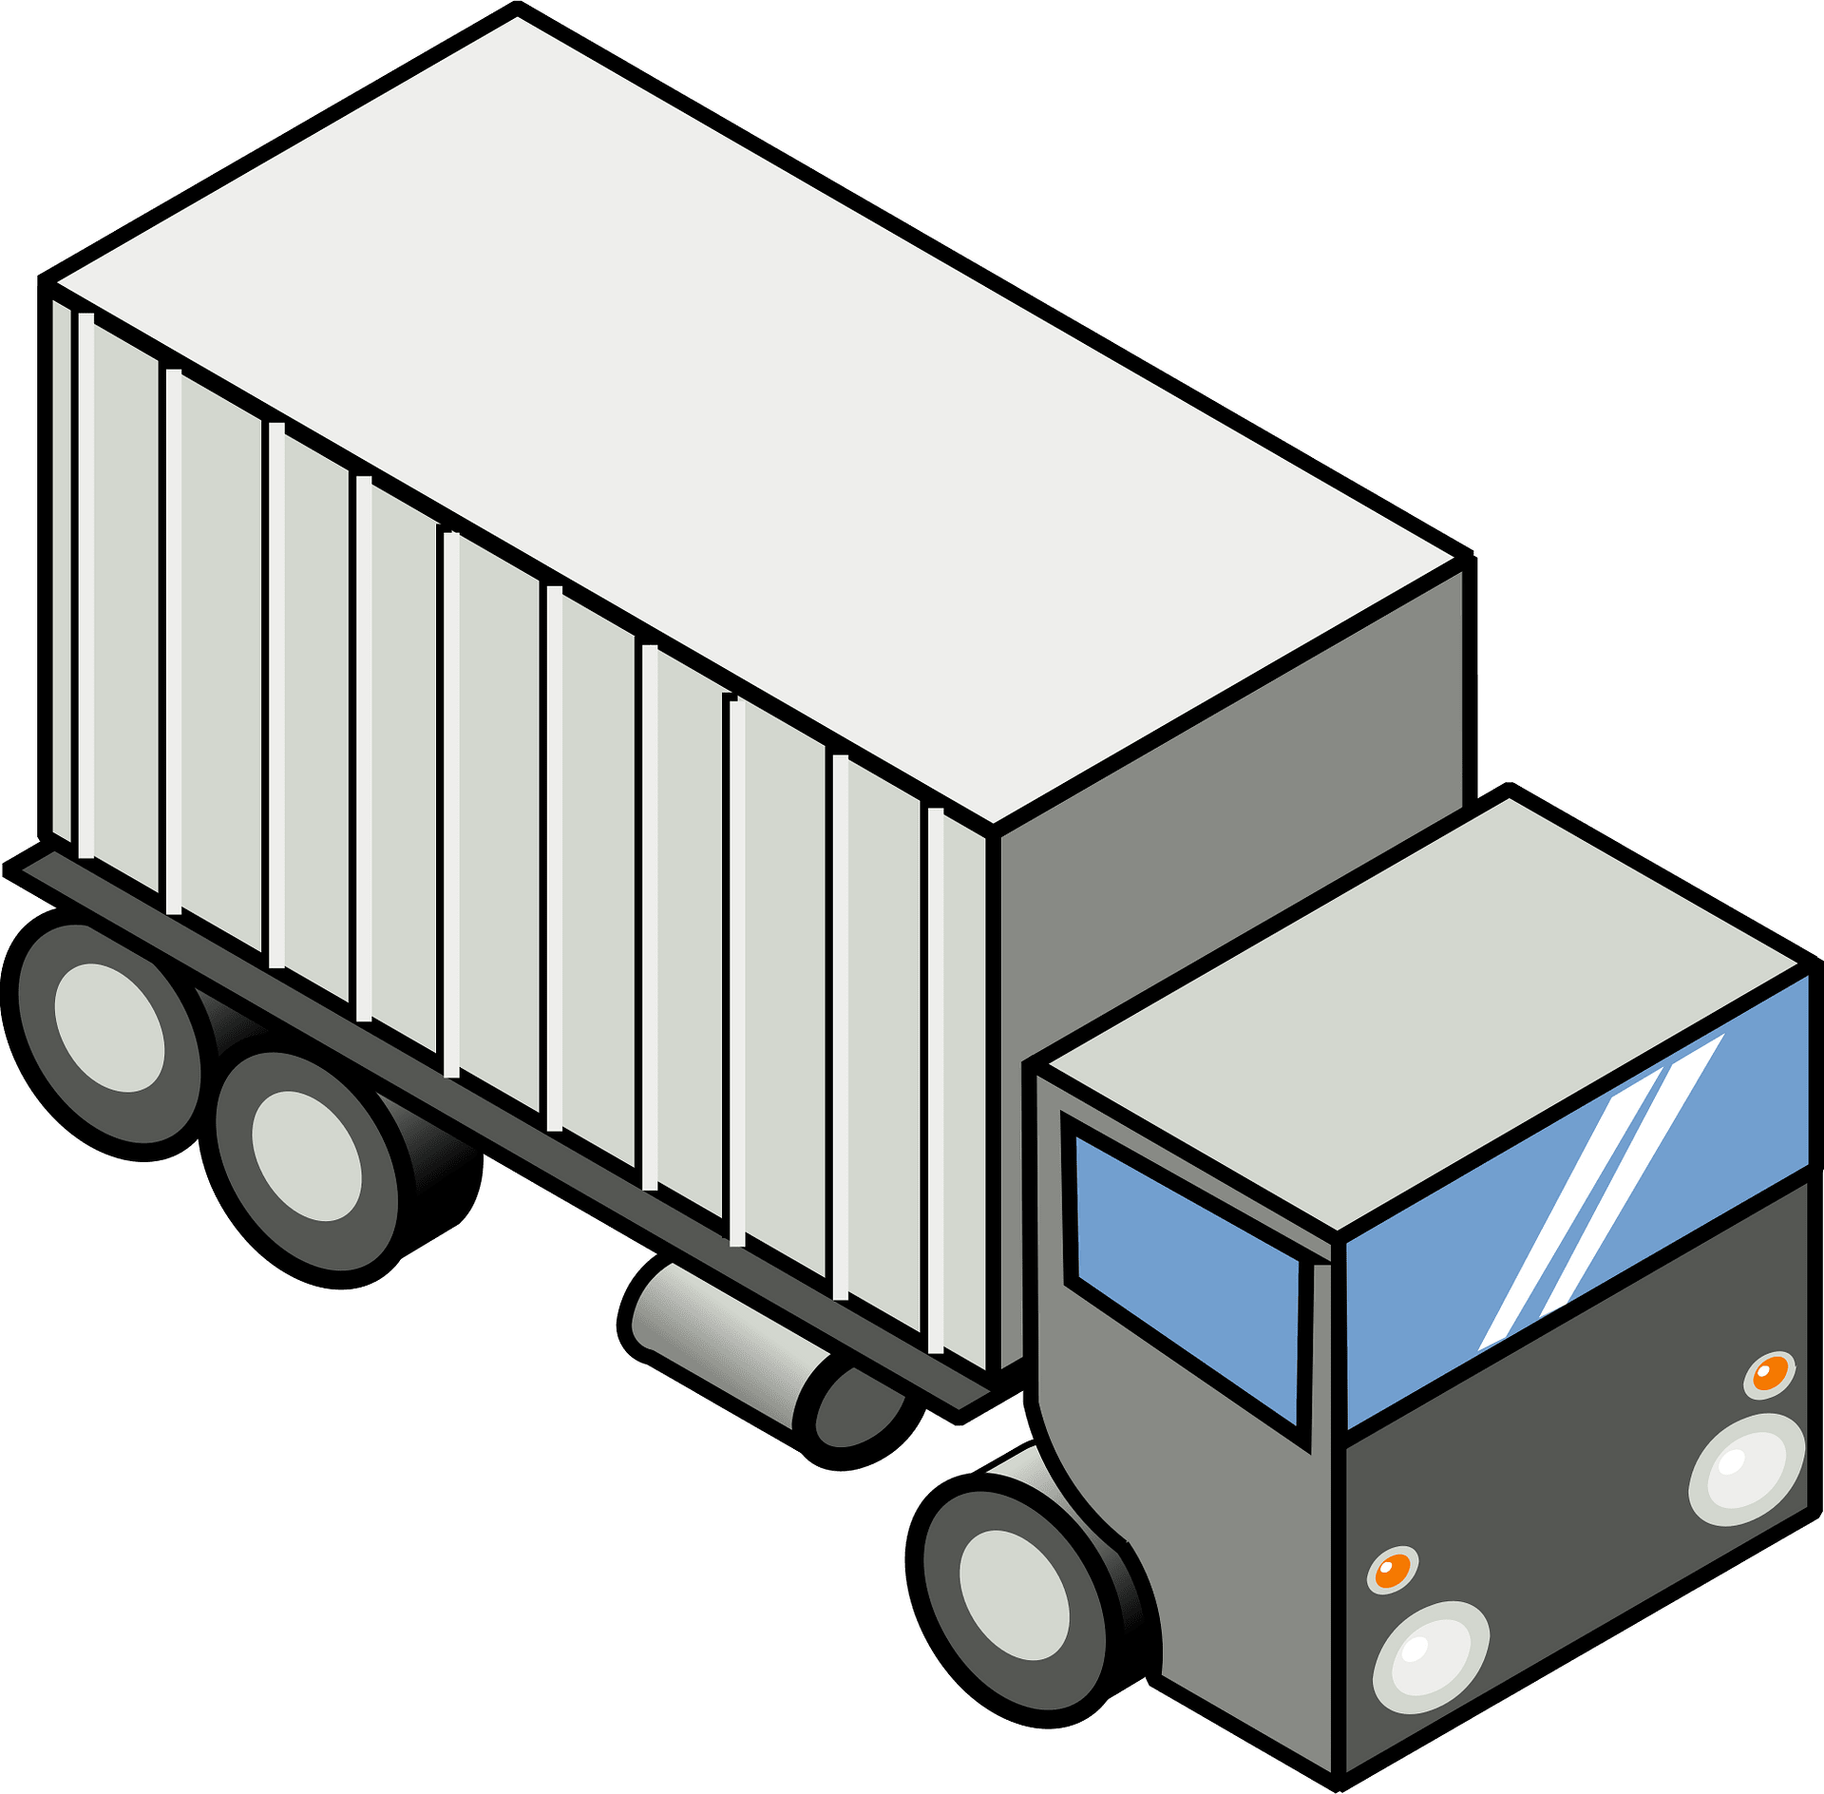
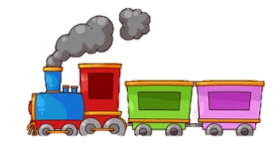
You request the photo
I send you the photo
Sending the picture protocol
Request Protocol
I tear the photo into pieces, put them in separate envelopes and drop them in the postbox
ME
Postal protocol
You get all of the envelopes and assemble them in the correct order to see the picture!
YOU
2
Post
Office
6
1
2
3
4
1
Post
Office
4
2
6
4
1
5
6
3
6
5
3
The post office sends all of the envelopes to YOU but each envelope can take a very different route to get to YOU and the envelopes might not arrive in order.
Notes:
Imagine you have a picture that you would like to send to your friend. However, you only have a bunch of small envelopes that are too small to fit the picture.
So, you tear the picture into a whole bunch of smaller pieces and put each piece in a different envelope. Each of these envelopes will have the address of your friend’s house.
Next, you put all of the envelopes in a postbox.
Now, it is the mail service’s job to deliver all of these envelopes to your friend. However, the mail service doesn’t make any promises about how these envelopes will be delivered. Some of them may be delivered by airmail

Slide 36
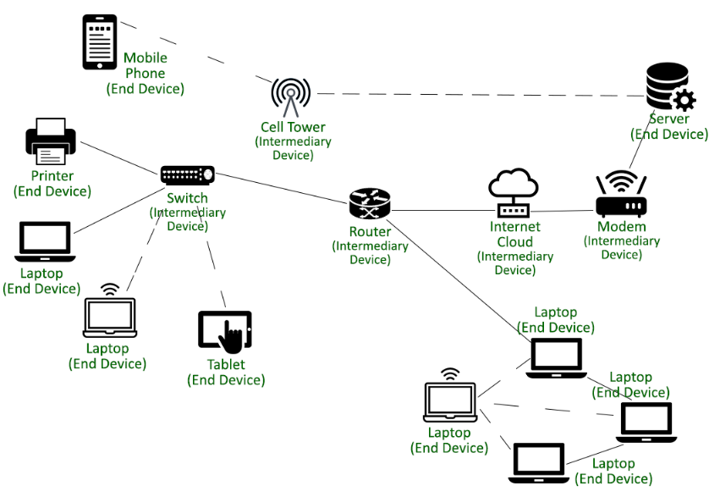
TCP/ip
http request
http response
TCP protocol
TCP Layer
disassembles our message into packets
talks to the destination using TCP
TCP
IP protocol
TCP
TCP Layer
Reassembles our packets into the correct order to make our message
2
IP
1
2
3
4
1
IP
6
4
2
6
4
1
5
6
3
6
5
3
The IP layer’s job is to get all those packets from the sender to the destination.
Each piece of photo (packet) can take all sorts of different routes to the destination and may arrive out of order.
The IP protocol concerns itself with getting each of the packets to the destination. It doesn’t care about the order
Notes:
Imagine you have a picture that you would like to send to your friend. However, you only have a bunch of small envelopes that are too small to fit the picture.
So, you tear the picture into a whole bunch of smaller pieces and put each piece in a different envelope. Each of these envelopes will have the address of your friend’s house.
Next, you put all of the envelopes in a postbox.
Now, it is the mail service’s job to deliver all of these envelopes to your friend. However, the mail service doesn’t make any promises about how these envelopes will be delivered. Some of them may be delivered by airmail

Slide 37
Let’s “inspect” it with our browser’s dev tools / network
page from our week 2
Notes:
Click on reload if there are problems

Slide 38
Actually, there is one extra step:
How do you find me to ask for the picture?
When we click on a link, the browser connects to a DNS (Domain Name Server) server to determine what the IP address is of the host we want to fetch the page from
Once we have that IP address, we can talk directly to the host
The TCP layer sends a request for the page to the TCP layer of the host
This request is carried to the host by the IP layer
The host TCP layer receives the request and packages up the page into packets that the IP layer sends back.
The browser receives this page from the TCP layer and begins rendering the page
For a much better explanation:
Populating the page: how browsers work - Web performance | MDN

Slide 39
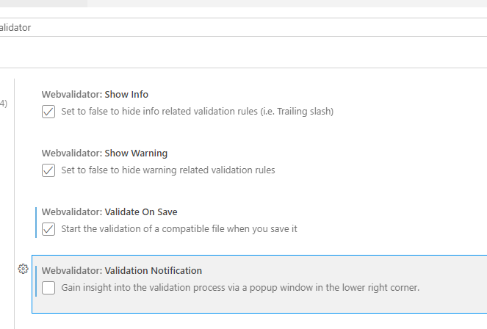

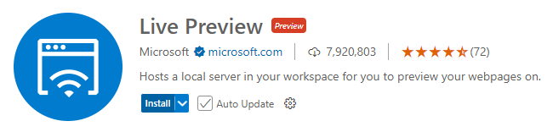
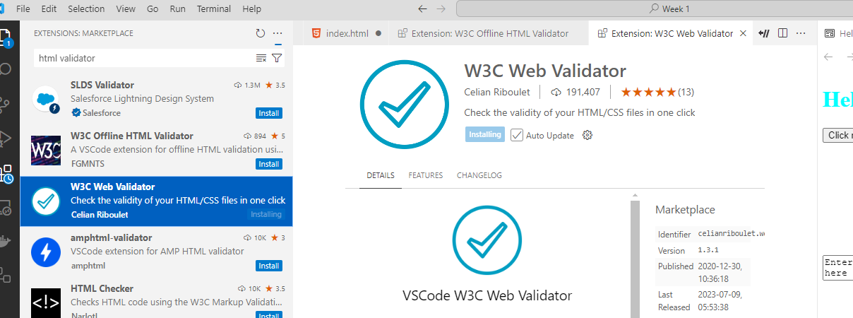
Installing VSCode
Visual Studio Code
And some extensions:

Slide 40
Let’s set up the file structure for the course

Slide 41
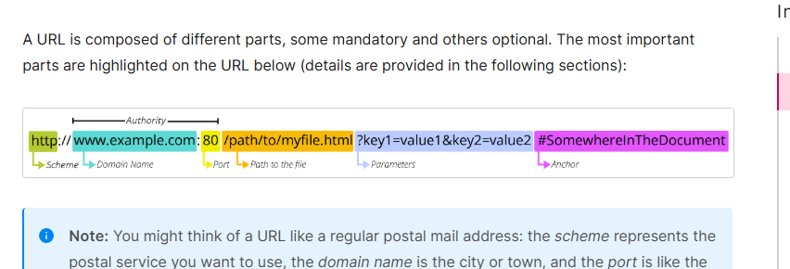
What is an (A?) url?
What is a URL? - Learn web development | MDN

Slide 42
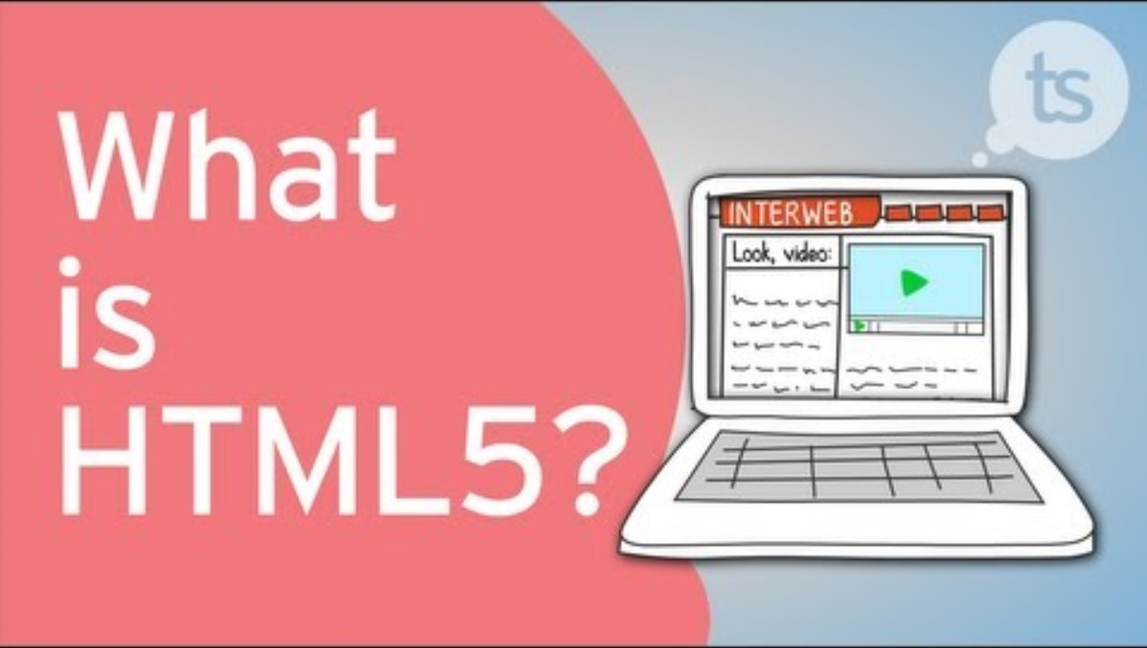

Some history of HTML 5
http://www.youtube.com/watch?v=mzPxo7Y6JyA

Slide 43

A camel is a horse designed by committee….

Slide 44
HTML 5
Hyper Text Markup Language, 5th version
HTML contains the content that we wish to display
HTML 5 is a markup language.
Everything is enclosed in tags
HTML describes the content that we are creating.
It does not describe how
to format the content
whatsoever!

Slide 45
What is CSS3?
CSS3 – Cascading Style Sheets 3rd version
CSS is used to format our content so that it looks pretty.
HTML is never used to format content.
CSS is never used to describe content.
HTML is important to ensure that our content is organized and can be indexed by search engines.
CSS is magic!
However, if the HTML is poor, no amount of CSS can save your page!

Slide 46
Go to CSS Zen Garden: The Beauty of CSS Design and start clicking
Every one of these pages use the EXACT same HTML – It’s just the CSS changing the look

Slide 47
So, what is javascript?
javascript is a programming script language that will give our websites more functionality and interactivity.
We won’t get too much into javascript in this course but the next course will cover this!
Interestingly, CSS3 can do a lot of stuff that we used to have to write javascript code for.

Slide 48
IC1 (In Class Assignment #1)
Sheridan provides a development server for you
Read through and follow these instructions:
  Follow the directions here: SYST10049 Setup Tasks
  Ensure that you follow all the steps to get Filezilla to connect to your server
Edit the helloworld.txt file that is in the w1 folder of your Week1 content. Follow the directions in the file.
Some example jokes…
  Two silk worms had a race…
  I stayed up all night wondering where the sun had gone…
  What is pink and fuzzy? What is blue and fuzzy?

Slide 49
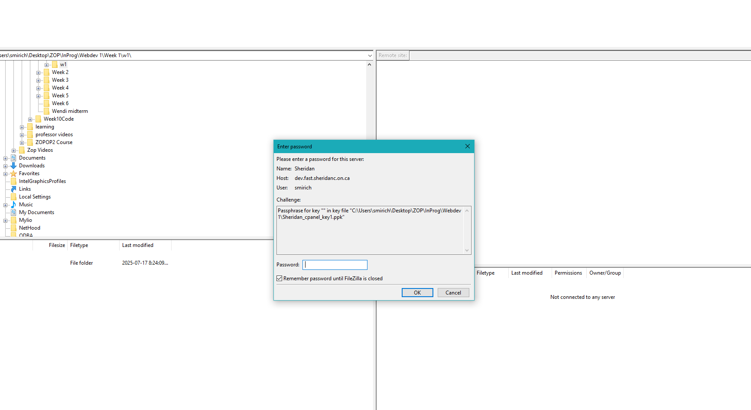
Start up Filezilla and login
Remember, it is asking you for your passkey password, not your Sheridan password!!!

Slide 50
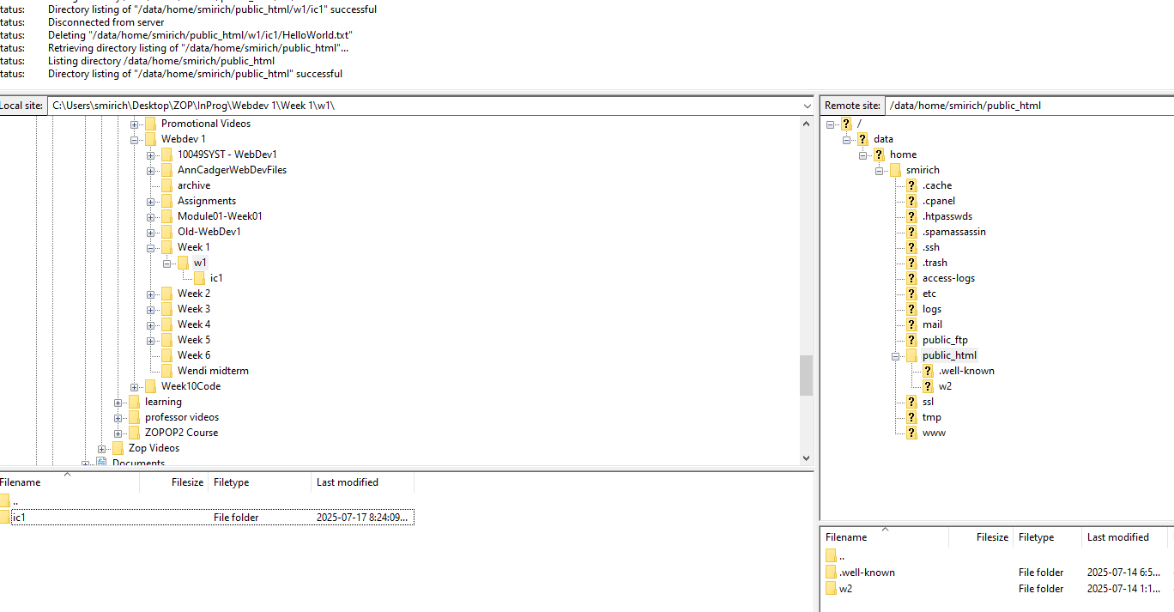
drag the w1 folder to the server
Drag the w1 folder to the public_html folder to initiate the transfer

Slide 51
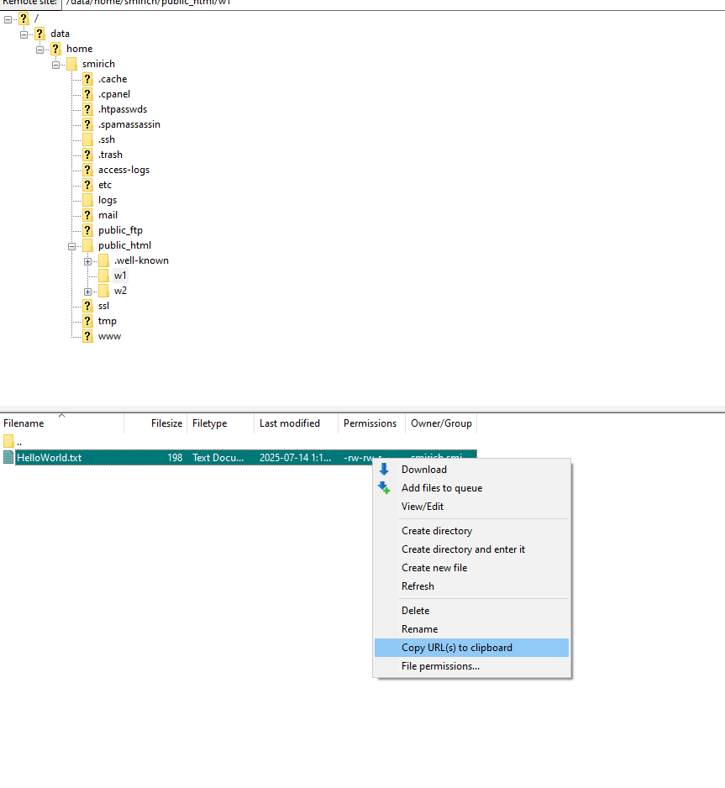
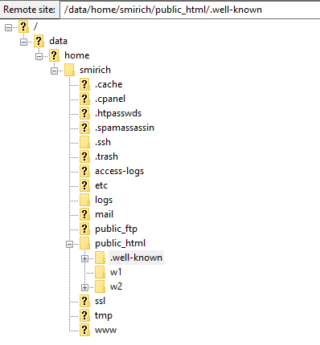
IC1 (In Class Assignment #1)
Read through and follow these instructions to move your w1 folder up onto the Sheridan server:
  How to Publish - SYST10049

Slide 52
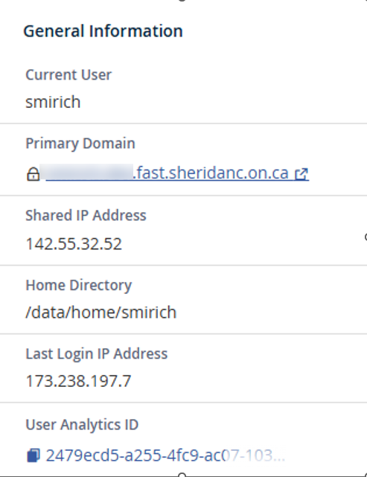
IC1 (In Class Assignment #1)
Submit the url from that file to Slate Dropbox so that I can visit it with my browser. If I can’t get to it, it results in a 0 on the assignment.
Due by Friday!!!
If you have problems, get help!!!
Important!!!
(test this url in your browser)
<userid>.dev.fast.sheridanc.on.ca/w1/ic1/HelloWorld.txt
This is the url to submit to dropbox. Test it in your browser before you submit it to dropbox to make sure your joke/quote shows up
Submit the url to the HelloWorld.txt file to dropbox.
Just add it to the comments section
If I can’t get to it, it results in a 0 on the assignment.
Due by Friday!!!
If you have problems, get help!!!
This information is on the landing page of your cpanel

Slide 53
This first IC1 is important!
If you don’t get your server set up correctly, you won’t be able to submit any of the assignments!
If you are having problems, ask for help!
Make absolutely sure that the URL that you submit to me will load the HelloWorld.txt file
Funniest joke gets midterm bonus marks!

Slide 54
end

